Slide 1

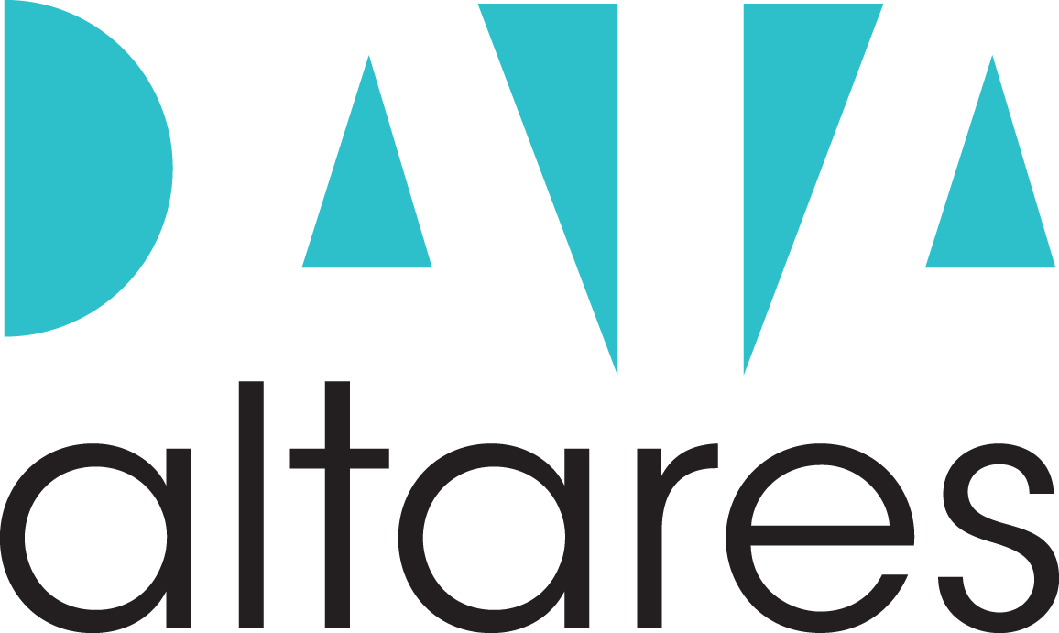
Project Baguette
Analytical support on Core Assets & Past Dynamics
To the attention of Altares Group’s management
March 2021
Paris Office
78 Avenue Raymond Poincaré
75116 Paris, France
www.eleven-strategy.com
Confidential

Slide 2
DISCLAIMER
In accordance with our agreement on our proposal date (the “Agreement”) between NewCo Altares (the “customer”) and eleven Strategy Consultants (“eleven”), we attach our report related to Core Assets & Past Dynamics analysis of Altares.
This document is confidential. It has been prepared by eleven for the sole use of the parties to whom it is addressed. Eleven will accept no liability or responsibility to any person other than the customer and then only as referred to in the Agreement. Eleven does not provide legal, accounting or tax advice. customer is responsible for obtaining independent advice concerning these matters, which advice may affect the guidance given by eleven.
The analyses and conclusions contained in this report were concluded within eight-week period.
The report is based upon information obtained from the customer and from other sources deemed to be reliable. Market analyses and projections represent eleven’s judgment, based upon data sources cited, and are subject to the validity of the assumptions noted herein.
For purposes of the analyses presented in this report, eleven has relied upon, and considered accurate and complete data obtained from the customer and its advisers, publicly available information, interviews with customers, competitors of the Group as well as market experts. Eleven has not independently verified the completeness or accuracy of that data and assumes no responsibility for it. No representation or claim is made that the results projected will actually be achieved.
It is expected that the recipient will conduct its own independent analysis. All estimates and projections contained in this report are based on data obtained from the sources cited and involve significant elements of subjective judgment and analysis, which may or may not be correct.
Eleven has made no undertaking to update these materials after the dates cited in the Agreement.

Slide 3
Overview of Altares’ core assets
Altares' offering and value proposition
Altares’ comprehensive offering
Altares’ premium value proposition
Altares’ loyal, resilient and diversified client base
Overview of the client base
Detailed analyses on French client base
Detailed analyses on Benelux client base
Detailed analyses on Manageo client base
Highlight of Altares’ other core assets
Altares’ structuring partnership with Dun & Bradstreet
Altares’ high-quality comprehensive data collection
Altares’ fine-tuned operating model
Appendix
Page 3
Page 5
Page 16
AGENDA
Page 22
Page 27
Page 39
Page 51
Page 60
Page 62
Page 66
Page 71

Slide 4







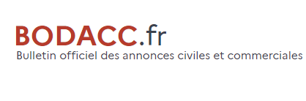








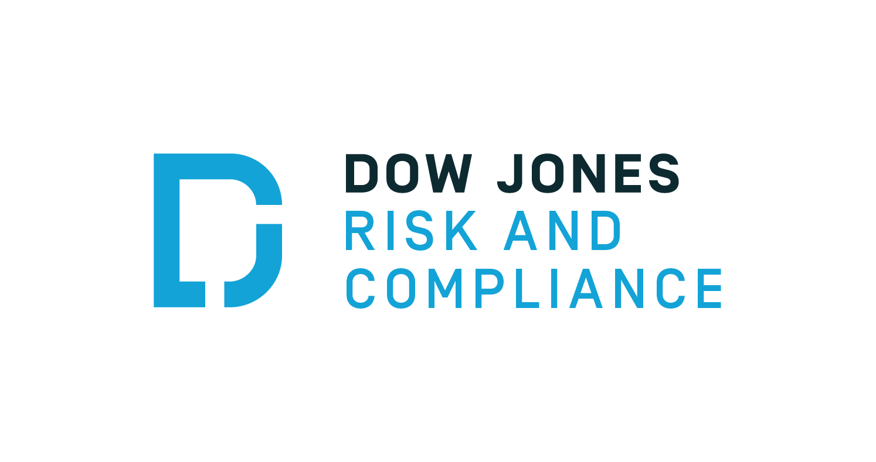
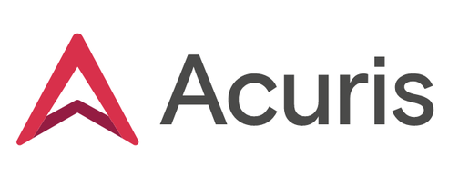



Altares’ value proposition consists in building and maintaining a global B2B database and exploiting it through high-value services for B2B clients
Altares’ key assets
Data & Operations
Altares' operational chain into the BD&A ecosystem
Data
providers
Altares
B2B clients
Data assets
Operating model
Offerings
Diversified, local and international data providers
Rich and highly differentiating data (e.g. Paydex)
An efficient upstream and downstream operational model supported by a robust IT architecture being modernized within the “DataHub” project
A strong and recognized high quality brand image in France, leaning on D&B to reinforce Altares brand in Benelux
Strongly resilient and diversified client base, both in terms of size, sector and geography
France
Altares « Data Factory »
Public data
Upstream : data collection and integration
Downstream : data analysis and offer deployment
Private data
Key accounts
Domestic data
Data collection
Data cleaning and processing
Data storage
Data analysis and delivery fulfilment
Customer Onboarding and success
Support
Credit risk
…
International data
Paydex data
Benelux
Compliance
Altares R&D
Public
R&D on data collection, cleaning, and enrichment (including NLP, data science…)
Scoring algorithm improvement
Product IT development
KBO entries
Compliance data
B2B marketing
…
*
Rest of the world
Product / offering conception
Digital data
Mid market
Partnership with
Historical partnership - running until 2031 - enabling Altares to benefit from D&B international data and very strong worldwide brand image
…
Sources: eleven research & analysis, company data, interviews with management
* Under discussion

Slide 5
Overview of Altares’ core assets
Altares' offering and value proposition
Altares’ comprehensive offering
Altares’ premium value proposition
Altares’ loyal, resilient and diversified client base
Overview of the client base
Detailed analyses on French client base
Detailed analyses on Benelux client base
Detailed analyses on Manageo client base
Highlight of Altares’ other core assets
Altares’ structuring partnership with Dun & Bradstreet
Altares’ high-quality comprehensive data collection
Altares’ fine-tuned operating model
Appendix
Page 3
Page 5
Page 16
AGENDA
Page 22
Page 27
Page 39
Page 51
Page 60
Page 62
Page 66
Page 71

Slide 6




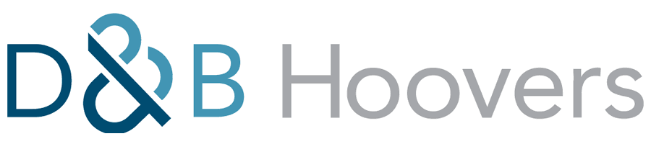




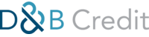
The data provided by Altares is needed at each step of the client lifecycle, from Prospection, to Compliance and to Credit risk management
Altares’ offering
Along client’ lifecycle
Mapping of Altares' offering throughout the client lifecycle
NEEDS FOR B2B LEADS TO PROSPECT NEW CLIENTS
NEEDS FOR COMPLIANCE INTELLIGENCE GENERATED BY LEGISLATION
NEEDS FOR Credit risk MANAGEMENT
Customer needs
B2B MARKETING
COMPLIANCE / KYC / KYS
Credit & financial risk
Lead identification & generation
Lead scoring
Sectorial analysis
UBOs¹ & PEPs² data
Compliance to KYC/AML laws
Business documents
Credit risk Information
Risk scoring
Altares' offering and products
mList, mAds, mLead
...
...
...
€18.8m
(20.0%)
€10.3m
(11.1%)
€63.5m
(68.9%)
FR & BNL revenue for 2020
(% of direct revenue³,
€92.6m)
Sources: eleven research & analysis, company data, interviews with management
1. UBO: Ultimate Business Owner 2. PEP: Politically Exposed Persons 3. Excluding incomes from D&B partnership

Slide 7

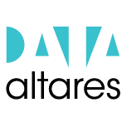







Altares’ products portfolio is split into Altares' proprietary products and D&B’s products, with three types of delivery, covering the three Altares' market verticals
Altares’ offering
Products & solutions
Selection of Altares' main offerings
Credit & financial risk
Compliance
B2B Marketing
Platform to perform market analysis and identify leads
Platform to monitor Credit risk and payment behaviour of French firms
Platform to facilitate KYC process for French companies
Platform to collect official documents
mList, mAds, mLead
See infra “Manageo”
Altares' proprietary products
Tools for lead generation, evaluation and building of ad campaigns
Batch files
Other services (e.g. data science)
Batch solution to cleanse and enrich client’s data with Altares' data and expertise
Transversal products
Connectors to integrate D&B’s data in the four leading CRM platforms (e.g., SAP) of the market
See infra “Transversal products”
API into D&B data repositories that can be used as is by Altares' clients and as data sources for all Altares' own products
Dun & Bradstreet products distributed by Altares
GB
Global Financials
Platform to monitor Credit risk management enriched with credit scores
Unique global data store for standardized financial reporting and analytics
Platform to facilitate KYC processes
Platform to access reliable, real-time information about all businesses, directors and sectors in 220 countries
Sources: eleven research & analysis, company data, interviews with management
Batch
Web platform
Connector/APIs

Slide 8



Illustration – Manageo: Manageo offers a wide range of B2B marketing solutions from lead generation to automated lead activation with mLead and mAds
Altares’ offering
Manageo’s products
Manageo’s offering overview
Manageo’s sales split by product types (2020)
Data enrichment
Prospect identification
Prospect scoring
Ad campaign automation
Free website to find financial and legal information about French firms.
mAds
Programmatic campaign to increase visibility
mList
Platform for lead generation
mLead
Multi-canal solution for qualified lead generation
mLead is currently being merged with mList and mDetect
API to automate data enrichment for clients
mDetect
“Cookization” of website to detect qualified lead
mData
Batch solution for data enrichment in clients’ CRM platforms
€8.25m
Total Manageo sales for 2020
Sources: eleven research & analysis, company data
Batch
Web platform
Connector/APIs

Slide 9
Altares’ solutions can be delivered in several ways depending on the level of personalization and integration into the clients’ workflow: from on-the-shelf web platform to tailor-made integrated solutions
Altares’ offering
Delivery modes
Altares solutions’ four types of delivery
Altares’ billing and booking distribution by delivery type in France and Benelux
On the shelf solutions
1
Client access to a web platform connected to Altares' database
Clients can search on the platform
Clients can then extract data they need and push it into their system
Altares’ billing in France by delivery type, in €m
Altares’ bookings in Benelux by delivery type, in €m
Web platforms
€42m
€42m
€43m
€41m
€47m
€46m
€47m
€45m
24.9%
23.9%
21.4%
21.2%
22.2%
22.6%
22.6%
18.6%
1.2%
1.8%
3.6%
4.3%
2.8%
4.3%
2
Connectors add an interface to use Altares' data in clients’ tools (e.g. CRM, ERP…)
Connector
46.8%
49.8%
47.0%
59.1%
57.2%
54.5%
52.4%
52.7%
3
Manual processing of clients’ data such as enrichment, cleaning or definition of customized indicators
The output of a batch solution is a file containing the enhanced data
0.0%
0.3%
1.4%
14.4%
Batch solutions
3.8%
4.5%
29.7%
25.5%
19.7%
10.0%
11.7%
16.9%
2017
2018
2019
2020
2017
2018
2019
2020
4
APIs allow the client to integrate directly Altares' data in their systems
APIs can be on-the-shelf or tailor made
They require the development of customized interfaces with the client
Batch
Connectors
Platform
Platform & API
API
Integrated solutions
API
Comments
Web platforms are the most significant delivery type in terms of revenue generation for Altares, representing ~62% of France billings (incl. Platform & API) and ~61% of Benelux bookings (incl. Platform & API)
Flagship products with high growth (e.g., intuiz+, indueD) are delivered in both Platform and API formats
Level of personalization in clients’ tools
Altares has teams dedicated to personalization of API and batch services for large and key accounts
See infra
Sources: eleven research & analysis, company data, interviews with management
1: Excluding D&B I billings and bookings, i.e. coming from D&B partnership

Slide 10
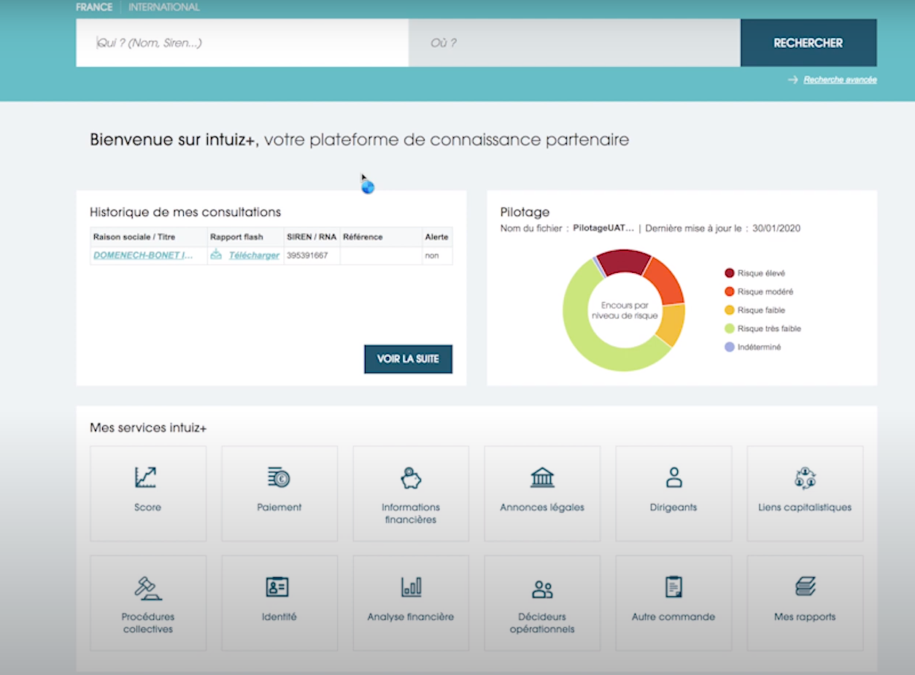
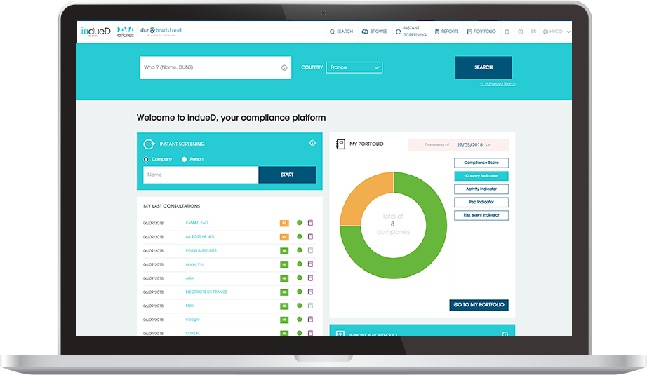
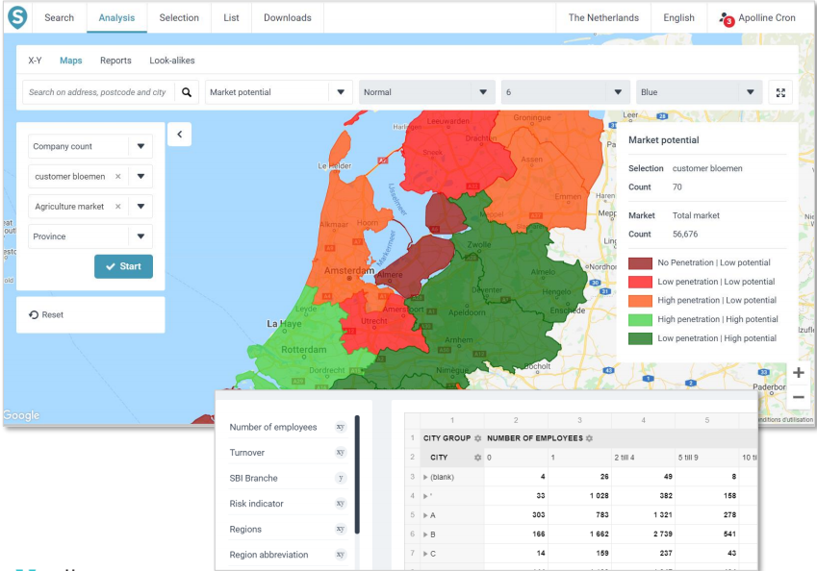


Illustration - Interface: Altares’ offerings is delivered either through user-friendly web applications, connectors inside clients’ tools, personalized batch or API
Altares’ offering
Delivery modes
Selected examples of Altares' client interface
Level of personalization in clients’ tools
Credit & financial risk
Compliance
B2B Marketing
None
1
Web platforms
2
Connector
3
Batch solutions
Tailor-made service
4
Altares has several kinds of APIs:
On-the-shelf APIs, ready to use by the client
Tailor-made API interfaces resulting of a combined work between Altares and each client individually
API
Sources: eleven research & analysis, company data, interviews with management

Slide 11
Credit risk solutions currently represent the main part of Altares’ turnover, while growth is mainly supported by compliance
Altares’ offering
Product dynamics
Evolution of revenue by LOB since 2017 (€m)
Comments
The three LOBs have different evolutions as demonstrated by the CAGR₁₇₋₂₀:
Credit risk: -2.3%
Compliance: +19.2%
B2B marketing: -0.5%
Altares’ growth is driven in France by compliance, particularly with the Sapin II law
Comments
The three LOBs have different evolutions as demonstrated by the CAGR₁₇₋₂₀:
Credit risk : -5.6%
Compliance: +9.3%
B2B marketing : +5.1%
Altares’ growth is driven in Benelux by both compliance and B2B marketing
Sources: eleven research & analysis, company data
1. LOB: Line of business

Slide 12

Transversal solutions, i.e. all the products making clients’ data more reliable and accurate, are progressively switching from batch solutions to integrated solutions
Altares’ offering
Product dynamics
Altares’ billing in France for Transversal products, in €m
Altares’ bookings in Benelux for Transversal products, in €m
Transversal products
Direct +
Business Add-On
Dataxess
D&B Connect
Datascience
Data manager
Batch files
Other
API / Connectors
Reading insights
Transversal products describe all the solutions that aim to improve the reliability and accuracy of business data
These products address the three lines of business and are dispatched within the presentation of the 3 LOBs
Some products exhibited are not present in the offering presentation as they are no longer in the roadmap (cf. p.7)
Comments
In France as well as in Benelux, there is an increasing demand for integration into clients’ system:
Connectors sales − Business Add-On and Dataxess − increased from €1.6m in 2017 to €2.4m in 2020 in France (CAGR₁₇₋₂₀: 26%) while it has increased from nothing (except from Dataxess revenues) in 2017 to €1.7m in 2020 in Benelux
Direct + API sales has increased from €1.3m in 2017 to €3.2m in 2020 (CAGR₁₇₋₂₀: 35%) in France and Benelux
The development of projects such as the Common Platform aims to facilitating the development of API
Sources: eleven research & analysis, company data, interviews with management

Slide 13
Altares’ offering
Altares is progressively rationalizing its Credit & financial risk products range in order to maintain its margins despite the decrease in sales
Product dynamics
Altares’ billing in France for Credit & financial risk products, in €m
Altares’ bookings in Benelux for Credit & financial risk products, in €m
Portfolio manager
DBAI/Toolkit/GDM
DNBi
DB Credit
intuiz+
Wynbe
Global Financials
Country Risk
Inforisk
Risk manageo
Transversal products
Other
Products merging
Reading insights
Transversal products, that address the three lines of business, are merged into a virtual category representing all the transversal sales related to Credit & financial risk
Some products exhibited are not present in the offering presentation as they are no longer in the roadmap (cf. p.7)
Comments
Clients with products such as DBAI/Toolkit/GDM, DNBi are being migrated towards D&B Credit to rationalize the client base
Wynbe customers that induced negative margin have been migrated towards intuiz+ and partner solutions
Altares is replacing old products with outdated pricing with new products better adapted to the market
Sources: eleven research & analysis, company data, interviews with management

Slide 14
Altares’ offering
Altares is increasing its customers retention on the fast-growing Compliance market by migrating its customer from one-off solutions towards recuring products
Product dynamics
Altares’ billings in France for Compliance products, in €m
Altares’ bookings in Benelux for Compliance products¹ in €m
High amount of compliances files due to the one-off CDC contract
Onboard
indueD
InDoc
LEI
Transversal products
Compliance Files
Other
Recurring products
Non-recurring products
Reading insights
Transversal products, that address the three lines of business, are merged into a virtual category that represents all the transversal sales related to Compliance
Some products exhibited are not present in the offering presentation as they are no longer in the roadmap (cf. p.7)
Comments
Altares has capitalized on the increasing demand for Compliance by launching indueD with strong sales increase (CAGR₁₈₋₂₀ being 380% in France and 270% in Benelux).
Non-recurring products are progressively replaced with recurring solutions, especially D&B Onboard and indueD, ensuring a better customer retention
Sources: eleven research & analysis, company data, interviews with management
1: two one-shot contracts with refunds in 2020 have been excluded from the analyses

Slide 15
Altares’ offering
B2B marketing activity past growth has been mainly supported by both Manageo’s products and transversal products with an increasing contribution by connectors solutions over the years increasing customer stickiness
Product dynamics
Altares’ incomes in France for B2B marketing products (Altares’ product in billings, Manageo’s in sales), in €m
Altares’ bookings in Benelux for B2B marketing products, in €m
Smart
Point Risk
Hoovers
Market insight
GRS
Programmatic (mAds)
Marketing perf. tools (mList)
Marketing perf. Files (mLead)
Other
Transversal solutions (API/ Connector)
Transversal solutions (one-off)
Manageo’s product (sales)
Reading insights
Transversal products, that address the three lines of business, are merged into a virtual category that represents all the transversal sales related to B2B marketing
Some products exhibited are not present in the offering presentation as they are no longer in the roadmap (cf. p.7)
Comments
Point Risk has been migrated towards Hoovers and SMART
Transversal B2B marketing solutions are switching from one-off contracts to connector integration ensuring revenue sustainability
Connectors and APIs (e.g., Dataxess) have known an important growth ensuring better customer retention
Decrease in mLead sales is mainly due to COVID-19 impact
Sources: eleven research & analysis, company data, interviews with management

Slide 16
Overview of Altares’ core assets
Altares' offering and value proposition
Altares’ comprehensive offering
Altares’ premium value proposition
Altares’ loyal, resilient and diversified client base
Overview of the client base
Detailed analyses on French client base
Detailed analyses on Benelux client base
Detailed analyses on Manageo client base
Highlight of Altares’ other core assets
Altares’ structuring partnership with Dun & Bradstreet
Altares’ high-quality comprehensive data collection
Altares’ fine-tuned operating model
Appendix
Page 3
Page 5
Page 16
AGENDA
Page 22
Page 27
Page 39
Page 51
Page 60
Page 62
Page 66
Page 71

Slide 17










Altares’ offering outperforms the competition thanks to the quality and comprehensiveness of its data, the accuracy of its analyses and its reliable brand image
Altares’ key assets
Value proposition
Altares’ key differentiating elements
Performance of players on the Credit risk market based on key differentiating elements
Weighted importance of each KPC for the three Altares’ client types
Credit risk
Compliance
B2B Marketing
1
Quality of the database
2
Reliability of the prediction score
n.a.
n.a.
3
Capacity to integrate into the client’s system
4
Price competitiveness
1
2
3
4
5
6
7
8
5
Availability of international data
6
Ability to provide the required level of service (inc. tailor-made analyses)
Ease of use of the solution
Altares’ Credit risk information offering is highly competitive and addresses large caps thanks to its brand image, and wide database
Altares solutions for compliance are known to be state-of-the-art in the market
Premium players offering more specific and added-value marketing solutions than local BD&A players, as they rely on their existing database and after-sales services already developed for their Credit risk solution, mostly benefiting larger corporates
7
8
Brand image
Sources: eleven research & analysis, expert calls

Slide 18


Altares’ offering in Credit & financial risk information appears highly competitive, especially to address large caps thanks to Altares’ high-quality brand image, comprehensive international database and ability to provide tailor-made services
Altares’ value proposition
Credit & financial risk
Detailed comparison of Altares with key competitors on Credit risk
Local players
Key differentiating elements
“Altares has an international network through its partnership, it gives them a strong brand advantage”
Former MD at Creditsafe
0
1
2
3
0
1
2
3
0
1
2
3
0
1
2
3
Quality of the database
Reliability of the prediction score
“Altares has teams dedicated to integration of its tools in clients’ IT system that allow them to provide tailor-made services”
Former sales at Ellisphère
Capacity to integrate into the client’s system
Price competitiveness
“Altares, in contrast to Companyweb, is a data firm rather than a tech firm”
Altares’ customer
Availability of international data
Ability to provide the required level of service (inc. tailor-made analyses)
“Altares provides its client with a high level of services: all the reports were provided to me quickly with the possibility of contacting them directly for further information.”
Legal & Compliance Director, Altares’ customer
Ease of use of the solution
Brand image
Weighted average
2.6
2.0
1.9
1
Sources: eleven research & analysis, expert calls

Slide 19
Altares compliance offering enjoys a very high level of customer recognition thanks to indueD, a quality solution with a user-friendly interface to efficiently perform time-consuming compliance tasks
Altares’ value proposition
Compliance
Detailed comparison of Altares with key competitors on compliance
“We selected indueD for [...] for the quality and clarity of summary reports and the dynamic data visualization that make us save precious time”
Compliance manager, Altares’ customer
Local players
Key differentiating elements
0
1
2
3
0
1
2
3
0
1
2
3
0
1
2
3
Quality of the database
“We can carry out an efficient and tailor-made screening which saves us a lot of time. This product is now standardized and responds as much to AFA rules as to those of the Group"
Anti-Corruption Compliance Project Leader, Altares’ customer
Capacity to integrate into the client’s system
Price competitiveness
“The ability of Altares to connect into our system through API has been our KPC.“
Data Advisor, Altares’ customer
Availability of international data
Reactivity: ability to update databases quickly and to adapt to clients’ needs
“Altares is very efficient in terms of services and data quality. It is a recognized, solid and reliable company recognized by the authorities.“
Legal & Compliance Director, Altares’ customer
Capacity to integrate enriched data sources
Ease of use of the solution
“We never see Ellisphere in the competition to answer Compliance calls for tender.”
CEO at Altares
Brand image
Weighted average
2.6
2.1
1.6
1.8
“BVD focuses on large accounts and its historical customers.”
CEO at Altares
Sources: eleven research & analysis, expert calls
Notes:
Quote sur indueD de client Altares (anonmyser les npms)
"We selected Altares' indueD platform in January 2019. First of all for the quality and clarity of the summary reports. Thanks to dynamic data visualization, these are very readable and very well presented, and make us save precious time with its red, orange or green “light” system.
CCO EDF
"We can thus carry out an efficient and tailor-made screening which saves us even more time. This model is now standardized and responds as much to AFA rules as to those of the Group"
Jean-Luc Le Moal, Country Anti-Corruption Compliance Project Leader de SKF France (induestrie)
The main indueD benefits: Make compliance a competitive advantage, Accelerate your decision-making KYC, The best of the data, Reconcile performance and compliance,

Slide 20

Altares, along with Manageo, offers a wide and competitive range of solutions for mid-sized companies as well as for large accounts
Altares’ value proposition
B2B Marketing
Detailed comparison of Altares with key competitors on B2B marketing
Local players
Key differentiating elements
0
1
2
3
0
1
2
3
0
1
2
3
0
1
2
3
“Very good experience, fast purchase, good data quality, bounce rate lower than 1% on my first email campaign on a sample of more than 13,000 lines. My client obtained several contacts following the campaign.”
Manageo’s Customer feedback (communication agency)
Quality of the database
Capacity to deliver an end-to-end offering
Price competitiveness
Availability of international data
“Manageo database is very rich and comprehensive. Working as director of a small business, lead generation is easily accessible for my company. Manageo solutions are easy to handle and have a reasonable price. The customer service is easily accessible.”
Manageo’s Customer feedback (Small-business director)
Capacity to integrate into the client’s system
Quality of the after-sales services
Ease of use of the solution and of contact management
Brand image
Weighted average
2.8
1.8
2.0
1.4
Sources: eleven research & analysis, expert calls

Slide 21
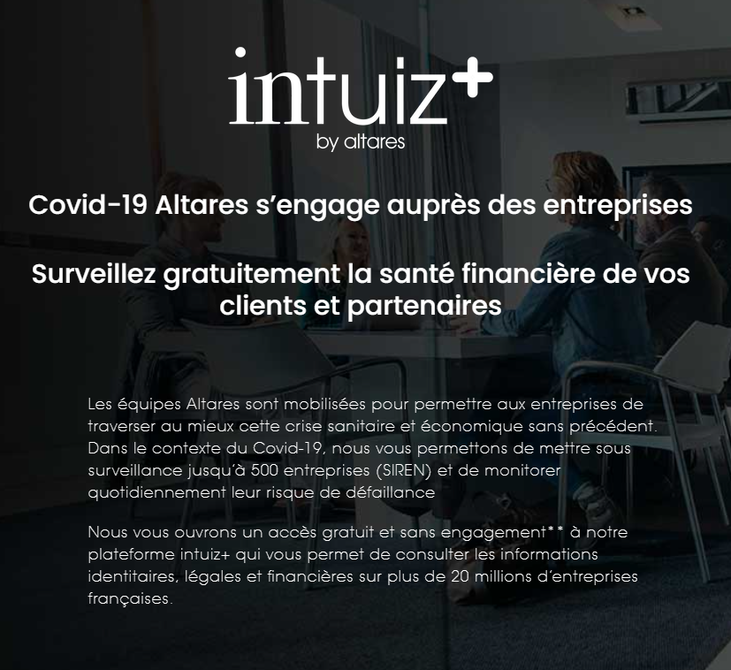






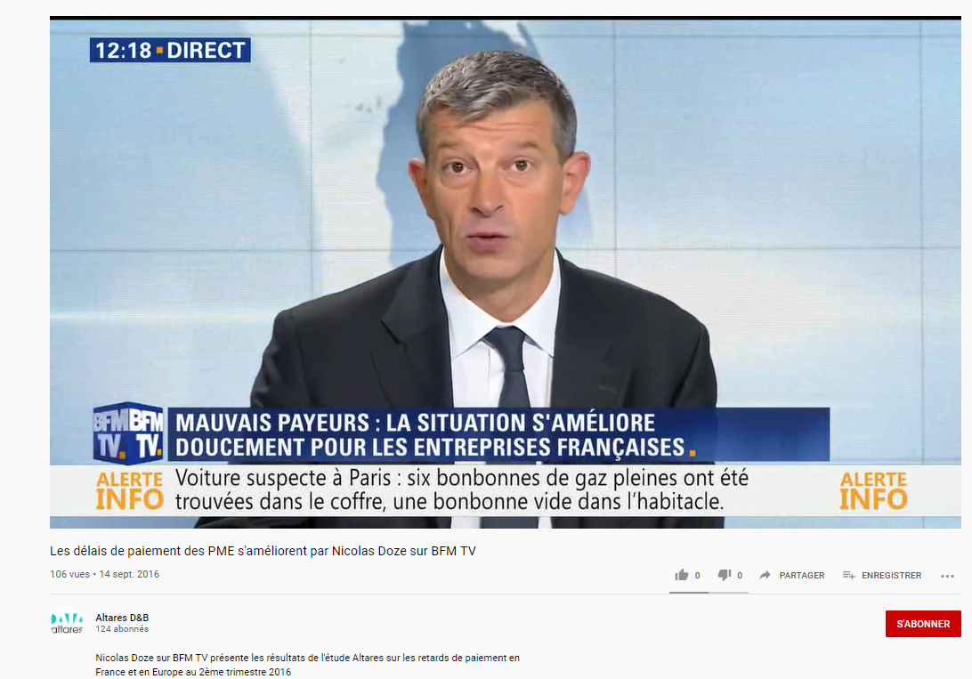
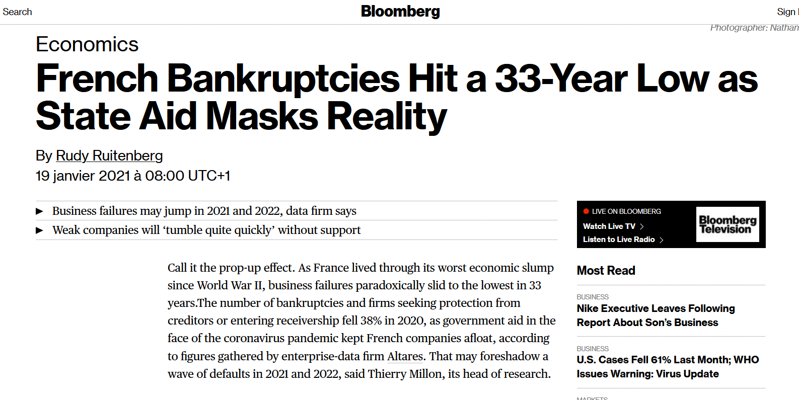
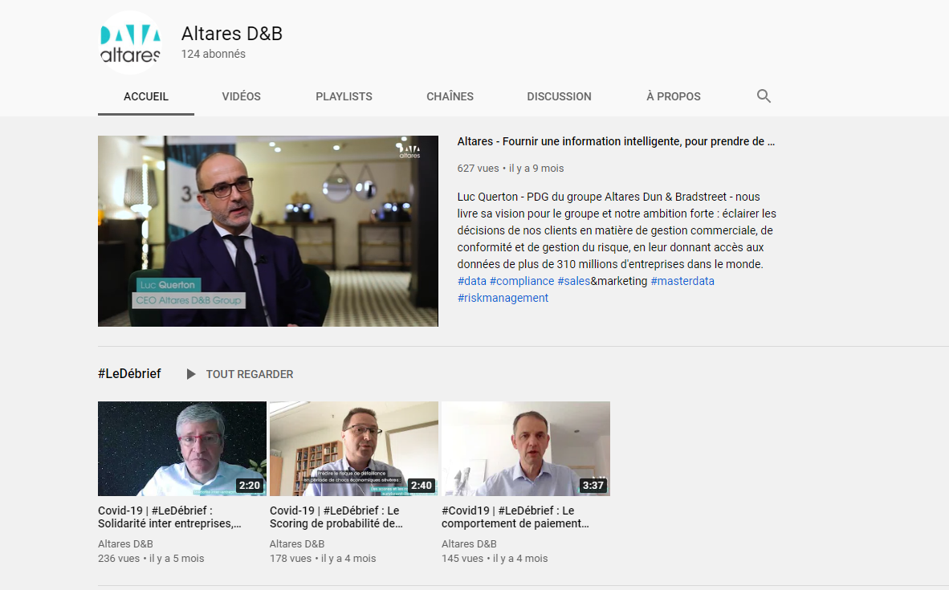
Altares’ strong and reliable brand image is proven over the years, and has been reinforced during the Covid-19 crisis with Altares publicly reinforcing its position of Credit risk expert
Altares’ value proposition
Brand image
Altares strong brand image has been proven over the years…
… and has been reinforced during the Covid-19 crisis as Altares is recognized as a Credit risk expert
Altares marketing performance (S2 2020)
Press
226 print in the press
22m of contacts
€1.22m of advertising space purchase
Marketing Campaigns
140 campaigns
540k contacts
Open rate ~14%
Click rate 21.6%
During the COVID-19 crisis, Altares has launched a freemium version of intuiz+ (for free during the period) and has been interviewed on BFM to discuss the COVID-19 impacts on the mid and large enterprises solvency risk in France
Altares specialist interviewed on BFM to discuss the impact of the COVID-19 crisis
January 2021 Bloomberg article
Altares Youtube Channel
Sources: eleven research & analysis, company data, interviews with management

Slide 22
Overview of Altares’ core assets
Altares' offering and value proposition
Altares’ comprehensive offering
Altares’ premium value proposition
Altares’ loyal, resilient and diversified client base
Overview of the client base
Detailed analyses on French client base
Detailed analyses on Benelux client base
Detailed analyses on Manageo client base
Highlight of Altares’ other core assets
Altares’ structuring partnership with Dun & Bradstreet
Altares’ high-quality comprehensive data collection
Altares’ fine-tuned operating model
Appendix
Page 3
Page 5
Page 16
AGENDA
Page 22
Page 27
Page 39
Page 51
Page 60
Page 62
Page 66
Page 71

Slide 23




Altares' customers are split into three distinct segments with different dynamics but also different characteristics
Altares’ client base
Altares’ three customer bases analysis methodologies
1
2
3
Numbers must be distinguished:
Booking values, i.e. the amount of money customers are committed to pay contractually
Billing values, i.e. the amount of money actually billed to the client
Sales, i.e. the amount of revenue resulting from commercial invoices only (excluding provisions and deferred)¹
Revenue, i.e. the amount of money actually earned
Years studied: 2017 to 2020
Quantity followed: billing values
Years studied: 2017 to 2020
Quantity followed: booking values
Years studied: 2017 to 2020
Quantity followed: sales¹
Whole sales database
Each line represents a deal
Whole sales database
Each line represent a deal
FAE/PCA/AAE
Scope of the analyses
Scope of the analysis
Manageo products being mainly one-shot services with a recurrence depending on the size of clients, the whole database has been analysed
One-off contracts
revenue coming from D&B partnership
Recuring contracts database
Scope of the analysis
Due to an evolution of contracts identification, analysed database contains both recurring and one-shot contracts with Altares’ clients
Scope of the analysis
Only recurring contracts with Altares’ clients
revenue coming from D&B partnership
Client analyses (billing / booking / Sales)
Client = group, i.e. a sum of entities that subscribe to contracts with Altares individually
2 821 groups analysed from 2017 to 2020
Client = group, i.e. a sum of entities that subscribe to contracts with Altares individually
3 498 groups analysed from 2017 to 2020
Client = group, i.e. the company that has bought a contract
5 523 groups analysed from 2017 to 2020
Client definition
Sources: eleven research & analysis, company data
1. Revenue = Sales from commercial invoiced + FAE (invoices to be established) + PCA (prepaid revenue) - AAE (prepaid expenses)

Slide 24
Scopes of the Bottom-up approach are focusing on non-DBI products and IAA for both France and Benelux and on Sales for Manageo
Altares’ future growth
BP assessment
Bottom-up
Altares’ three Bottom-up approach methodologies
1
2
3
Revenue
Total revenue 2020 (from BP): €54.9m
Total revenue 2020 (from BP): €52.6m
Total revenue 2020 (from BP): €8.6m
Billings: €54.9m
Bookings: €54.0m
Bookings: €8.6m
IAA
€1.1m
D&Bi
€9.3m
FAE/PCA/AAE²
€0.3m
+
D&Bi
€12.3m
+
+
+
Non-D&Bi
€44.7m
Sales: €8.3m
One-shot¹ products
€2.8m
+
Client analyses (billing / booking / Sales)
Recurring products
€38.7m
Scope of the customer cohorts’ analysis
Scope of the customer cohorts’ analysis
Scope of the customer cohorts’ analysis
Sources: eleven research & analysis, company data; 1 : Analysis and studies, on-demand data, exchange of goods, file delivery and enrichment, trainings, scoring…; 2. FAE (invoices to be established) + PCA (prepaid revenue) - AAE (prepaid expenses);

Slide 25
Furthermore, scopes of the pipeline analysis are smaller than the total revenue in France, Benelux and Manageo as they relate to the Book of Business generated in 2020
Altares’ client base
Altares’ three customers base analysis methodologies
1
2
3
Revenue
Total revenue 2020 (from BP): €54.9m
Total revenue 2020 (from BP): €52.6m
Total revenue 2020 (from BP): €8.6m
Book of Business¹: €49.47m
Book of Business¹: €54.09m
Book of Business¹: €8.09m
Others ²
€ 2.17m
Renewal D&BI
€9.27m
+
Pay as you go
€3.27m
+
+
Renewal D&BI (incl. IAA)
€13.45m
Renewal (excl. D&BI)
€36.38m
+
Pipeline Analyses (CRM)
Renewal (excl. D&BI)
€29.58m
+
+
NetNew
€8.44m
NetNew
€6.47m
Scope of the pipeline analysis
Scope of the pipeline analysis
Scope of the pipeline analysis
Database from Salesforce CRM
Database from Salesforce CRM
Database from Microsoft Dynamics CRM
Sources: eleven research & analysis, company data
1. Book of Business represents the won opportunities in the pipeline 2. Others include alliances, partnerships and barter

Slide 26
In 2020, 96% of Altares business in France can be considered as a recurring business and 97% in Benelux
Altares’ pipeline
Altares’ share of recurring vs. non-recurring business in France (2019 vs. 2020)
Altares’ share of recurring vs. non-recurring business in Benelux (2019 vs. 2020)
Pipeline Analyses
Recurring portion of the business
(95%)
Recurring portion of the business
(97%)
Sources: eleven research & analysis, company data
Pipeline salesforce.com (incl. DBI from REC)

Slide 27
Overview of Altares’ core assets
Altares' offering and value proposition
Altares’ comprehensive offering
Altares’ premium value proposition
Altares’ loyal, resilient and diversified client base
Overview of the client base
Detailed analyses on French client base
Detailed analyses on Benelux client base
Detailed analyses on Manageo client base
Highlight of Altares’ other core assets
Altares’ structuring partnership with Dun & Bradstreet
Altares’ high-quality comprehensive data collection
Altares’ fine-tuned operating model
Appendix
Page 3
Page 5
Page 16
AGENDA
Page 22
Page 27
Page 39
Page 51
Page 60
Page 62
Page 66
Page 71

Slide 28
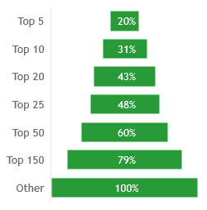
Altares revenue are mainly generated by large customers and share of top 20 clients within total clients has been increasingly growing in terms of billings generated
Altares’ client base
France
Overview of Altares' top clients in France
Evolution of the distribution of France top clients in the total sales (in % of total sales)
Breakdown of billings across the client base (in %), 2020
Evolution of the distribution of France top clients in the total sales (in €m)
Comments
Share of top 25 clients within total clients has been increasingly growing in terms of billings generated showing Altares’ strong ability to “farm” its top clients
Total ~ €41.5m¹
1 806 clients
Sources: eleven research & analysis, company data
1: Only on direct booking i.e. excluding D&B partnership incomes

Slide 29
Altares’ client base
In France, Altares has built a resilient customer base from diversified industries with a focus on key accounts representing 62% of total customers
France
Altares’ billings split per customer size, France (2019)
Altares’ billing split per customer industry segmentation, France (2019)
Altares revenue are focused on key accounts, including 90% of CAC40 companies which allows for a strong resilience thanks to their aversion to change and the complex integration within their systems.
Altares has developed a diversified customer base of ~4000 clients within 2100 companies
Sectorial repartition of 2019 90% billings
Mass market
Mid market
€37.5m billings of Altares in France in 2019 (DPB¹ excluded)
Public
Key accounts
Sources: eleven research & analysis, company data
1. “Division Partenariats Bancaires”: indirect distribution channel through banking partnership
Notes:
charts

Slide 30
Altares’ penetration rate within CAC 40 is up to 90% showing Altares’ ability to be a privileged partner of large companies in France
Key insights on Altares’ remaining “white space” to conquer
Altares customers
Non-Altares customers
Comments
Altares’ already counts 36 CAC40 customers within its clients (i.e. 90% penetration rate), meaning it is a privileged partner of French big companies with still a little “white space to conquer” within CAC40
Large potential to grow the average basket within these accounts
70% of the sales come from Paris area, where 87% of the sales are with large and medium size firms
Comments
Altares’ top 25 customers billings split per LOB shows that there is still white space to conquer for each client, except within the Risk LOB (as risk products are Altares historical business)
Sources: eleven research & analysis, company data

Slide 31
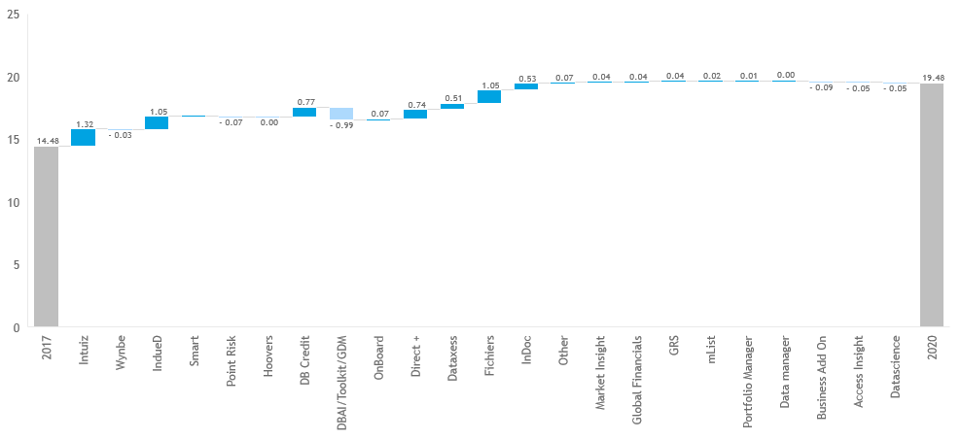
Altares’ France top 25¹ customers are all multi-product purchasers with intuiz+ and indueD being the most subscribed products
Altares’ client base
France
Highlight on Top 25 clients' billings split by product between 2017 and 2020 (in €m)
Flagship products
Other products
+ €1.29m
+ €0.99m
- €0.22€
Negative values due to product migration
Comments
Billings generated by top 25 customers have been growing from €14.5m to €19.5m
Products with negative values are most of the time being converted to “flagships” products (e.g., Wynbe towards intuiz+)
Sources: eleven research & analysis, company data
1. As of 2020 (incl. Jumbos + following 5 customers)

Slide 32

Altares’ French database contains all revenues in France, including indirect DB&I and one-shot revenue, and thus must be removed to recurring revenue to study customers cohorts
Altares’ client base
France
Evolution of Altares’ billings in France between 2017 and 2020, in €m
Total revenue 2020 (from BP): €54.9m
Billings: €54.9m
IAA
€1.1m
+
D&Bi
€12.3m
+
One-shot products
€2.8m
+
Recurring products
€38.7m
Scope of the French cohort analyses
Scope of the customer cohorts’ analysis
Sources: eleven research & analysis, company data

Slide 33
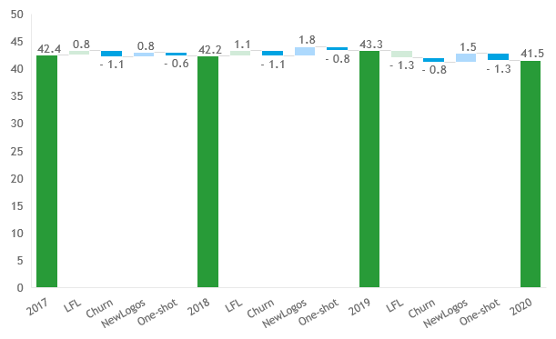
In France, churn dynamics show both upsell in existing customers and strong capability to attract new customers to compensate churn
Altares’ client base
France
Waterfall of Altares’ billings in France between 2017 and 2020, in €m
Reading insights
Like-for-like can be either positive if Like-for-like customers have on average generated more sales than the previous year (up-sell) or negative if they have on average generated less sales than the previous year (down-sell)
This cohort doesn’t contain D&B partnership revenue
One client is a group
Comments
Lfl client generate on average more and more up-sell: Altares has put in place a powerful “farmer” client management
New business is continuously above churn showing good hunter dynamics
Altares has developed an efficient customer portfolio management with:
Significant upsell in historical customers
New business offsetting churn
2 major clients won in 2019 (in financial sectors), with major potential in the coming years
1 client lost in 2019 and won back in 2020 (in public sector)
1 client lost in 2020 (in technology sector): the main reason for the cancellation was the price but Altares’ sales team believe that Direct+ with the Data Blocks would have helped keeping the business.
Description of categories
LFL : All clients that generated revenue in years Y and Y+1 and then include up-sell, down-sell and sales same as previous
Churn : All clients that generated revenue in year Y and not in year Y+1
NewLogos : All clients that generated revenue in year Y and not in year Y-1
Sources: eleven research & analysis, company data

Slide 34
In France, cohorts’ dynamics illustrate Altares’ focus on high value-added customers at the expense of unprofitable small accounts, as billings have increased despite a decreasing number of clients
Altares’ client base
France
Evolution of Altares’ billings in France broken down by customers’ recruitment year, in €m
Evolution of Altares' number of clients in France broken down by customers’ recruitment year
Customers’ recruitment years:
CAGR₁₇₋₂₀: -0.4 %
<2018
2018
2019
2020
Total
90% of 2020 revenue were generated by customers recruited prior to 2018
Comments
Cohort includes all sales generated by customers in a given year excluding indirect incomes coming from the partnership with D&B (e.g. royalties…) and one-off sales (e.g. files products and tailored services…)
Altares' customer base has proven its resilience over time as 90% of its 2020 turnover comes from customers acquired prior to 2018 (i.e. 2017 and before), while preserving a robust customer acquisition rate
Since 2017, Altares has tightened its customer base from ~1736 in 2017 to ~1595 customers in 2019 but has managed to increase upsell as the total generated revenue has increased from c. €36.9m in 2017 to c. €39.2m in 2019 and c. €38.6m in 2020, showing high resilience in period of covid crisis
Increase in number of clients from 2019 to 2020 is partly due an increased need for compliance products in time of COVID
Sources: eleven research & analysis, company data

Slide 35
In France, ARPU evolution shows Altares' ability to significantly upsell historical large accounts as well as small new accounts, as ARPU of each cohort increases every year
Altares’ client base
France
Evolution of ARPU broken down by customer recruitment year in €
Evolution of ARPU broken down by year in €
Cohort prior 2018 contains large clients recruited several years ago (before 2017) explaining a significantly higher ARPU
Customers’ recruitment years:
Reading insights
ARPU is the Average Revenue Per Unit, a unit being a single customer
“Group” is the company customer referential
Comments
ARPU broken down by customer recruitment year shows onboarding around €6k and an increase year on year
Large customers, being historical Altares’ customers, drive the ARPU up
The global ARPU confirms that analysis with value increasing every year (except in 2020 due to the Covid effect that deprioritized data-related expenses within Altares’ customers)
It confirms Altares customers’ farming ability, enabling a strong upsell dynamic
Sources: eleven research & analysis, company data
Notes:
Doc source:
RESULTATS_COHORTES

Slide 36
In terms of commercial pipeline, the new sales organization in France has enabled a positive growth of NetNew opportunities creation in the past 4 months after the negative impact of Covid-19 crisis
Altares’ client base
France
Key takeaways regarding pipeline evolution in France – NetNew opportunities
Key takeaways
Monthly evolution of created pipeline
(in €m, June 2019 - February 2021, NetNew opportunities - France)
On average, monthly pipeline creation has been down by 28% in 2020 vs. 2019
Good trend in risk supported by environment and fly to quality (27% in 2019 vs. 33% in 2020 of created pipeline)
S&M activities have been heavily impacted by various lock down in France (20% in 2019 vs. 13% in 2020 of created pipeline)
Compliance and MDM remain steady as compliance and digitization projects remain a priority for customers
Decrease in NetNew creation pipeline between 2019 and 2020 can be explained by
A weakened sales team in 2020 (about 40% of the sale force has been renewed and upgraded - 19 salespeople have been recruited in 2020) 34 vs. 35 productive FTE
Covid-19 crisis
Very positive trend on created pipeline over the past 4 months, that can be explained by the new sales organization (i.e. systemization and industrialization of commercial processes) and the post-crisis rebound
€3.5m
€3.0m
€2.5m
2.2
€2.0m
€1.5m
€1.0m
€0.5m
€0.0m
January
February
March
April
May
June
July
August
September
October
November
December
2019
2020
2021
Monthly evolution of the conversion rate (3-Months rolling average)
(in %, March 2019 - February 2021, NetNew opportunities - France)
50%
45%
40%
35%
Increase in conversion rates between 2019 and 2020 can be explained by
D&B high-end brand image (e.g. quality, reliability) that reassures customers in period of crisis
A higher focus by sales people on closing opportunities rather than creating new ones because of the crisis
30%
25%
20%
15%
10%
5%
0%
January
February
March
April
May
June
July
August
September
October
November
December
2019
2020
2021
Sources: eleven research & analysis, company data

Slide 37
In terms of commercial pipeline, renewal won opportunities in France shifted towards a more predictable revenue structure with more Multi-Year and less One-off contracts between 2019 and 2020
Altares’ client base
France
Key takeaways regarding pipeline evolution in France – Renewal opportunities
Key takeaways
Yearly evolution of the won Renewal opportunities (in €m, in %, 2019 - February 2021, Renewal opportunities - France)
Increase in won renewal opportunities values (~€40m in 2019 vs. ~€43m in 2020) can be explained by client's will to minimize risk during the Covid-19 crisis (no appetite to switch to another data provider)
Increase in recurring opportunities (i.e. Multi-Year, Rolling and Single) and decrease in One-off opportunities is giving confidence regarding a more stable and predictable revenue structure
€41.4m
0.2%
€43.6m
0.4%
€5.7m
2.8%
3.9%
-0.3%
2019
2020
2021
Reading insights
Multi-Year: contract for which several years are already booked
Rolling: contracts with an annual tacit renewal (associated with cancellation notice period)
Single-Year: contracts with one-year duration only
One-Off: contracts for punctual needs of the clients
Multi-Year
Rolling
Single
One off
Not labeled
Monthly evolution of the retention rate - (3-Months rolling average) (in %, March 2019 - February 2021, Renewal opportunities - France)
96%
95%
95%
95%
94%
94%
94%
94%
94%
92%
92%
92%
93%
91%
92%
92%
90%
92%
91%
89%
90%
91%
88%
89%
89%
89%
89%
88%
88%
Steady retention rate between 2019 vs. 2020 with a slight increase in the past 4 months
0%
January
February
March
April
May
June
July
August
September
October
November
December
2019
2020
2021
Sources: eleven research & analysis, company data

Slide 38
Overview of Altares’ core assets
Altares' offering and value proposition
Altares’ comprehensive offering
Altares’ premium value proposition
Altares’ loyal, resilient and diversified client base
Overview of the client base
Detailed analyses on French client base
Detailed analyses on Benelux client base
Detailed analyses on Manageo client base
Highlight of Altares’ other core assets
Altares’ structuring partnership with Dun & Bradstreet
Altares’ high-quality comprehensive data collection
Altares’ fine-tuned operating model
Appendix
Page 3
Page 5
Page 16
AGENDA
Page 22
Page 27
Page 39
Page 51
Page 60
Page 62
Page 66
Page 71

Slide 39
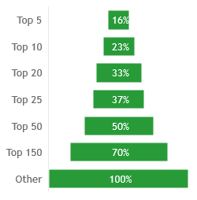
Altares revenue are mainly generated by large customers, with top 10 clients being listed companies in Benelux
Altares’ client base
Benelux
Overview of Altares' top clients in Benelux
Evolution of the distribution of Altares’ top clients in Benelux in the total bookings
Breakdown of bookings across the client base (in %), 2020
Evolution of the distribution of Altares’ clients in Benelux in the total bookings (in €m)
Total ~ €44.7m¹
2 021 clients
Comments
Shares of the whole top 150 clients are increasing showing the consolidation of Benelux database around the largest clients and Altares’ strong ability to “farm” its top clients
Sources: eleven research & analysis, company data
1: Only on direct booking i.e. excluding D&B partnership incomes

Slide 40
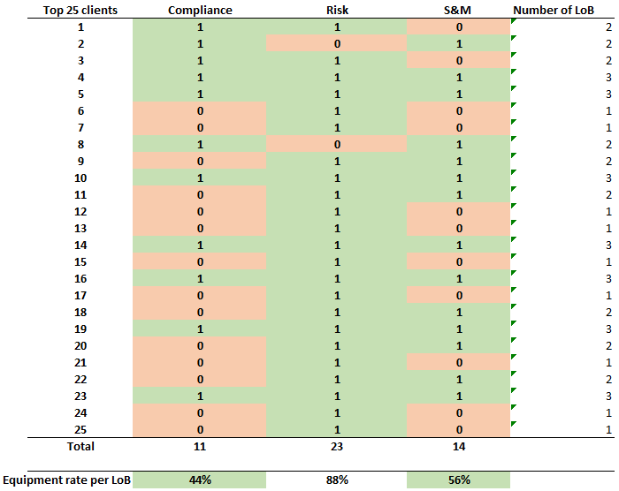
Altares’ penetration rate within BEL 20 and AEX 25 is at 90% showing Altares’ ability to be a privileged partner for large companies in Benelux
Altares’ client base
Benelux
Key insights regarding Altares’ remaining “white space” to conquer in BNL
BEL MID customers repartition
BEL 20 customers repartition
AMX customers repartition
AEX 25 customers repartition
Altares customers
Non-Altares customers
Comments
Altares’ already counts 50% of BEL 20 customers and 88% of AEX 25 customers, highlighting its privileged partner position for Benelux large companies
Comments
Altares’ top 25 customers bookings split per LOB shows that there is still white space to conquer for each client, except within the Risk LOB (as risk products are Altares historical business)
Sources: eleven research & analysis, company data

Slide 41
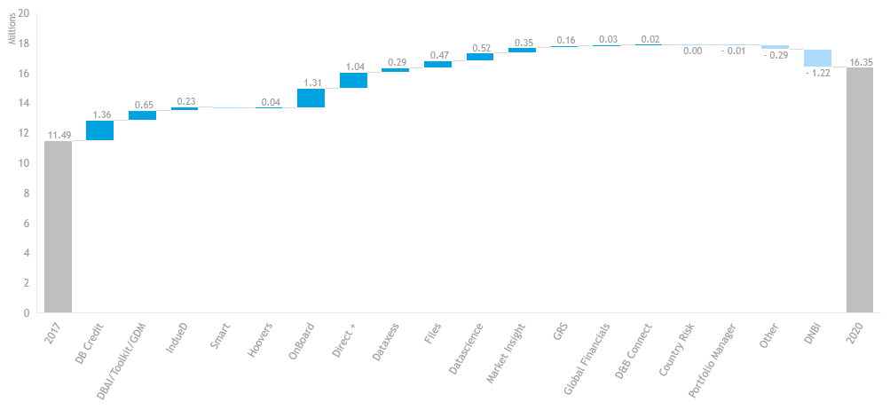
Altares’ BNL top 25 customers¹ are all multi-products purchasers with D&B Credit and indueD being the most consumed products
Altares’ client base
Benelux
Highlight on Top 25 clients' billings split by product between 2017 and 2020 (in €m)
Flagship products
Other products
+ €0.17M
+ €2.01M
Negative values due to product migration
Comments
Both DBAI/Toolkit/GDM and DNBi clients are being migrated towards D&B Credit in order to rationalize and update products offering. The drop in DBAI/Toolkit/GDM is due to this migration.
Sources: eleven research & analysis, company data
1. As of 2020 (incl. Jumbos + following 5 customers)

Slide 42
Altares’ Benelux database contains all revenues from Benelux, including indirect DB&I and one-shot revenue, but due to a change in one-shot contract identification only DB&I revenue can be excluded from customers cohorts
Altares’ client base
Benelux
Evolution of Altares’ bookings in Benelux between 2017 and 2020, in €m
Total revenue 2020 (from BP): €52.6m
Bookings: €54.0m
D&Bi
€9.3m
+
Non-D&Bi
€44.7m
Scope of the Benelux cohort analyses
Scope of the customer cohorts’ analysis
Sources: eleven research & analysis, company data

Slide 43
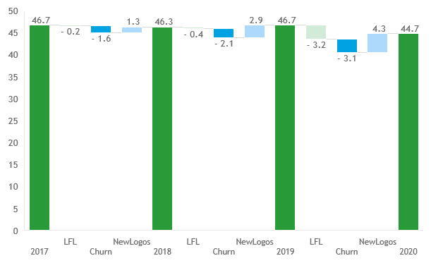
In Benelux, Altares is characterized by a strong customer acquisition, as new business offset both churn and down-sell on existing customers
Altares’ client base
Benelux
Waterfall of Altares’ bookings in Benelux between 2017 and 2019 in €m
Reading insights
Due to a change in one-off contracts identification between 2017 and 2020, the split between recurring and one-off contracts can’t be done efficiently
A client that stopped paying a product in 2018 and started paying again in 2019 is included in the category “new business 2019” while it is not a “new” client in the database
Comments
New business is systematically offsetting churn showing Altares strong customer “hunting” ability
Top 20 clients (representing 37% of total bookings) are characterized by very stable acquisition dynamics:
Almost no churn between 2017 and 2020 (only one client lost in 2020 in a deal facing BVD)
Three major contracts won in 2020 (One facing Graydon, one in the public sector, one in 2020 with a very strong potential for the future in the delivery sector)
Other clients are characterized by positive acquisition dynamics as new logos are systematically offsetting churn, especially in 2020 when:
Churn shrank due to COVID-10 crisis (changing data provider was not the top priority)
LFL shrank a bit due to down-sell in existing customers (but is expecting to be punctual)
Description of categories
LFL : All clients that generated revenue in years Y and Y+1 and then includes up-sell, down-sell and sales same as previous
Churn : All clients that generated revenue in year Y and not in year Y+1
NewLogos : All clients that generated revenue in year Y and not in year Y-1
Sources: eleven research & analysis, company data

Slide 44
Benelux cohorts’ dynamic illustrates Altares’ focus on high value-added customers at the expense of unprofitable small accounts, as bookings have remained flat despite a decrease in the number of clients
Altares’ client base
Benelux
Evolution of Altares' bookings in Benelux broken down by customers’ recruitment year, in €m
Evolution of Altares' number of clients in Benelux broken down by customers’ recruitment year
Customers’ recruitment years:
<2018
2018
2019
2020
86% of 2020 revenue were generated by customers recruited prior 2018
Comments
Cohort includes all sales generated by customers in a given year excluding indirect incomes coming from the partnership with D&B (e.g. royalties…)
Altares' customer base has proven its resilience over time as 82% of its 2020 turnover comes from customers acquired prior 2017, while preserving a robust customer acquisition rate
Since 2017, Altares has tightened its customer base from ~2281 in 2017 to ~2000 customers in 2020 but has managed to increase upsell as the total generated revenue has remained stable
Sources: eleven research & analysis, company data

Slide 45
In Benelux, ARPU evolution shows Altares' ability to significantly upsell historical large accounts as ARPU of each cohort as well as global ARPU are increasing every year
Altares’ client base
Benelux
Evolution of ARPU broken down by customer recruitment year, in €
Evolution of ARPU broken down by year, in €
Cohort prior 2018 contains large clients recruited several years ago explaining a significantly higher ARPU
Customers’ recruitment years:
Reading insights
ARPU is the Average Revenue Per Unit, a unit being a single customer
“Group” is the company customer referential
Comments
ARPU broken down by customer recruitment year shows an increase year on year.
Large customers, being historical Altares’ customers, drive the ARPU up
The global ARPU confirms this analysis with a value increasing every year
It confirms Altares customers’ farming ability, enabling strong upsell dynamics
Sources: eleven research & analysis, company data
Notes:
Doc source:
RESULTATS_COHORTES

Slide 46
In terms of commercial pipeline, Covid-19 crisis had a negative impact on Benelux pipeline creation and conversion rate but this has been mitigated by a positive recent trend since September 2020
Altares’ client base
Benelux
Key takeaways regarding pipeline evolution in Benelux – NetNew opportunities
Key takeaways
Monthly evolution of created pipeline
(in €m, June 2019 - February 2021, NetNew opportunities – Benelux)
Decrease in NetNew creation between 2019 and 2020 can be explained by Covid-19 crisis impact
Very positive trend on pipeline creation in the past 4 months that can be explained by customers realizing that projects need to continue despite Covid-19 crisis
Exceptional decrease in December 2020 explained by a higher focus on conversion of opportunities than acquisition of new business
Expected increase driven by the new sales organization established in February 2021 focusing on NetNew Business
€3.5m
€3.0m
€2.5m
2.2
€2.0m
€1.5m
1.3
€1.0m
€0.5m
€0.0m
January
February
March
April
May
June
July
August
September
October
November
December
2019
2020
2021
Monthly evolution of the conversion rate (3-Months rolling average)
(in %, March 2019 - February 2021, NetNew opportunities - Benelux)
Decrease in won opportunities between 2019 and 2020 due to a contraction of the market (Covid-19 crisis)
Increase in lost opportunities between 2019 and 2020 can be explained:
Lost opportunities were not lost to competitors but due to shift in priorities of customers because of the sanitary crisis
Lost opportunities consisted mainly in deals dropped or postponed (higher lifetime of opportunities in the salesforce.com database during 2020) by the customers
55%
50%
45%
40%
35%
30%
25%
20%
15%
10%
5%
0%
January
February
March
April
May
2019
June
2020
July
August
September
October
November
December
2021
Sources: eleven research & analysis, company data

Slide 47
In terms of commercial pipeline, renewal won opportunities in Benelux shifted towards a more predictable revenue structure with more Rolling and fewer Single and One-off contracts between 2019 and 2020
Altares’ client base
Benelux
Key takeaways regarding pipeline evolution in Benelux – Renewal opportunities
Key takeaways
Yearly evolution of the won Renewal opportunities (in €m, in %, 2019 - February 2021, Renewal opportunities - Benelux)
In March/April 2020, slight decease in successful renewal opportunities because of the beginning of Covid-19 crisis
Increase in values and retention rate won opportunities between 2019 and 2020 due to client's will to minimize risk during the Covid-19 crisis (no appetite to switch to another data provider)
€42.2m
€45.6m
€4.6m
0.6%
0.0%
2.4%
Reading insights
Multi-Year: contract for which several years are already booked
Rolling: contracts with an annual tacit renewal (associated with cancellation notice period)
Single-Year: contracts with one year duration only
One Off: contracts for punctual needs of the clients
-0.2%
-0.1%
Negative figures comes from customers’ refunds
-1.2%
2019
2020
2021
Multi-Year
Rolling
Single
One off
Not labeled
Sources: eleven research & analysis, company data

Slide 48
Overview of Altares’ core assets
Altares' offering and value proposition
Altares’ comprehensive offering
Altares’ premium value proposition
Altares’ loyal, resilient and diversified client base
Overview of the client base
Detailed analyses on French client base
Detailed analyses on Benelux client base
Detailed analyses on Manageo client base
Highlight of Altares’ other core assets
Altares’ structuring partnership with Dun & Bradstreet
Altares’ high-quality comprehensive data collection
Altares’ fine-tuned operating model
Appendix
Page 3
Page 5
Page 16
AGENDA
Page 22
Page 27
Page 39
Page 51
Page 60
Page 62
Page 66
Page 71

Slide 49
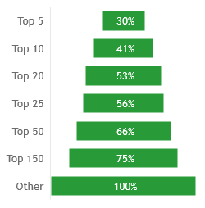
Manageo large customers sale surges as the share of top client has been increasingly growing
Altares’ client base
Overview of Altares' top clients for Manageo
Evolution of the distribution of Manageo’s top clients in the total sales, in % of total sales
Breakdown of Manageo sales across the client base in % of 2020
Evolution of the distribution of Manageo’s top clients in the total sales, in €m
Comments
Share of top 50 clients within total client base has been increasingly growing in terms of sales generated – from 53% in 2017 to 66% in 2020 (the top 25 clients from 45% in 2017 to 56% in 2020) demonstrating:
Manageo’s commercial initiatives to develop key accounts
Manageo’ strong ability to “farm” its top clients
Total ~ €8.25m
1 821 clients
Sources: eleven research & analysis, company data

Slide 50



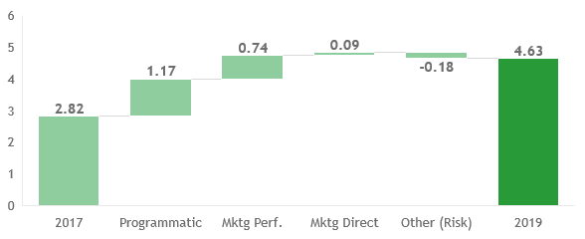
Manageo’s clients combine both communication agencies and corporates, addressed with different products
Altares’ client base
Manageo’s target clients
Highlight on Top 25 clients
Waterfall of Manageo sales of Top 25 clients between 2017 and 2019, in €m
Communication agencies
Clients managed by dedicated sales representatives
They mostly need Programmatic tools such as mAds (~70% of the revenue), as well as Lead generation (marketing performance) products such as mLead (~30% of the revenue)
Key corporate accounts
Clients dedicated sales representatives
They mostly need lead generation with marketing performance products, such as mData, mLead, and files
Comments
Manageo has focused on increasing the share of large clients in its portfolio, balanced between communication agencies (~55% of 2020 Top 25) and large corporates (~45%)
Manageo has invested in their product to make them meet key accounts’ needs
Investments have been made to improve the functionalities dedicated to key accounts, and to ensure the robustness for large data needs
The transition from mLead (direct lead) to mList (lead generation tool) generates more recurring business
The organization and the incentives of sales representatives have been improved
For instance, a middle market team has been set up to target medium-sized companies in telesales, knowing that these companies naturally have less churn than small companies.
Small and medium corporate clients
Clients via Telesales with specifics sales representatives focused on acquisition
The flagship product is mostly mList (platform for lead generation) with annual contracts
Sources: eleven research & analysis, company data

Slide 51
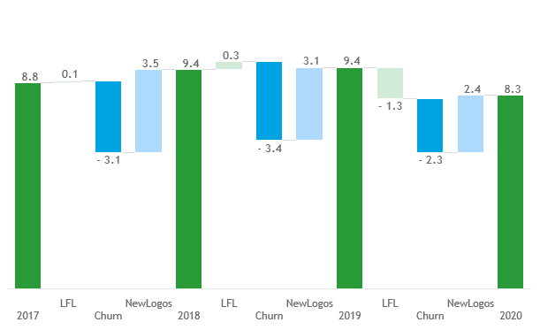
Manageo steady growth relies on strong customer acquisition offsetting natural churn over the years as Manageo’s activity is mainly characterized by one-off products
Altares’ client base
Waterfall of Manageo’ sales between 2017 and 2020, in €m
Comments
Manageo is mainly a business of conquest: the big communication agencies are loyal over time (very little churn), but the corporates generally change providers every two years (i.e. they stay 2 years and come back 2 years later).
Regarding communication agencies, Manageo has a lot of white space
Manageo addresses 100% of the big B2B media agencies (the top 5 being Dentsu, OMD, HAVAS, Publicis, Group M). These agencies surf on the strongly growing trend of programmatic (despite from the lockdown period in 2020)
For the past 1.5 years, Manageo has strengthen its commercial strategy over smaller independent agencies and has successfully penetrated their ecosystem
In addition, Manageo also reaches agencies in other countries with its programmatic offering (Belgium, Switzerland...)
In 2020, the Covid stopped growth, that is strongly resuming in 2021
The drop was stronger in jumbo clients as all the campaigns were stopped (explaining the 2020 downsell of €-1m on jumbo clients)
At the same time, Manageo managed to acquire a lot of new logos, especially mid-sized and small communication agencies during the same period
Description of categories
LFL : All clients that generated revenue in years Y and Y+1 and then includes up-sell, down-sell and sales same as previous
Churn : All clients that generated revenue in year Y and not in year Y+1
NewLogos : All clients that generated revenue in year Y and not in year Y-1
Sources: eleven research & analysis, company data

Slide 52
Manageo customers dynamics show that Manageo succeeded in upselling its historical customers and thus increasing its overall booking despite a reduction in the number of clients
Altares’ client base
Evolution of Manageo’s sales broken down by customer recruitment year, in €m
Evolution of Manageo’s number of clients broken down by customers’ recruitment year
Customers’ recruitment years:
CAGR₁₇₋₁₉: -9%
<2018
2018
2019
2020
Total
50% of 2020 revenue were generated by customers recruited prior 2018
Comments
Manageo' customer base has proven its resilience over time as 77% of its 2020 turnover comes from customers acquired prior 2020, and 50% prior 2018, while preserving a robust customer acquisition rate
Since 2017, Manageo has tightened its customer base from ~2370 in 2017 to ~1960 customers in 2019 but has managed to increase upsell as the total generated revenue increased from ~€8.8m in 2016 to ~€9.5m in 2019
In 2019, the decrease of the 2018 cohort is partially due to the reorganization of communication agencies (a portion of the 2018 cohort might be in the 2019 cohort but not visible due to changes in billings entities)
In 2020, the impact of Covid crisis was important due to major contraction in clients’ marketing budgets, but the rebound is already visible
Sources: eleven research & analysis, company data

Slide 53
ARPU evolution shows Manageo' ability to upsell historical accounts as ARPU of each cohort as well as global ARPU are increasing every year until Covid crisis
Altares’ client base
Evolution of ARPU broken down by type of products, in €
Evolution of ARPU broken down by year, in €
CAGR₁₇₋₁₉: 14%
Cohort prior 2018 contains clients recruited several years ago explaining a significantly different ARPU level
Customers’ recruitment years:
Reading insights
ARPU is the Average Revenue Per Unit, a unit being a single customer
Company is the customer referential
Comments
ARPU broken down by customer recruitment year shows onboarding around ~€2.5-3k and an increase year-on-year
The global ARPU confirms the analysis with a value increasing every year besides 2020. This growth has been slightly and temporarily modified with the Covid Crisis and significant contraction of marketing budgets (CAGR₁₇₋₁₉ of ~14% and CAGR₁₇₋₂₀ of ~7%).
It confirms Manageo customers’ farming ability, enabling a strong upsell dynamic
Sources: eleven research & analysis, company data
Notes:
Doc source:
RESULTATS_COHORTES

Slide 54
In terms of commercial pipeline, the creation reveals a positive trend after the Covid-19 impact in 2020 vs. 2019 mainly driven by Agencies opportunities
Altares’ client base
Key takeaways regarding pipeline evolution for Manageo
Key takeaways
Monthly evolution of created pipeline
(in €m, 2019 - 13th Feb. 2021, All opportunities - Manageo)
Positive trend in pipeline creation starting from Q4 2020 after a negative impact during the first COVID-19 lockdown
€3.0m
2.8
2.6
€2.5m
2.4
2.4
2.0
1.9
2.1
1.9
1.9
€2.0m
2.1
1.7
1.5
1.8
1.7
1.7
€1.5m
1.8
1.8
1.9
1.8
1.5
1.0
1.1
1.1
1.6
€1.0m
1.0
€0.5m
0.9
For February 2021, data only until 13/02
€0.0m
January
February
March
April
May
June
July
August
September
October
November
December
2019
2020
2021
Yearly evolution of created pipeline by customer category
(in €m, 2019 - 13th Feb. 2021, All opportunities - Manageo)
Decrease in pipeline creation between 2019 and 2020 is mainly due to COVID-19, mainly impacting Key Accounts
Positive trend for Agencies with a positive growth starting from the end of Q4 driving an increase in won opportunities between 2019 and 2020 despite COVID-19 crisis
€21,6m
€20,7m
€3,7m
6,5%
Reading insights
Agencies: large communication agencies
Key accounts: large corporate companies
Telesales: call centers companies
2019
2020
2021
Data until February 13th for 2021
Agencies
Key Accounts
Telesales renewals
Telesales
Sources: eleven research & analysis, company data

Slide 55
In terms of commercial pipeline (CRM), Covid-19 had a negative impact on Manageo conversion and retention rates but that can be explained by the global economic conditions and thus that is expected to be a one-off event
Altares’ client base
Key takeaways regarding pipeline evolution for Manageo
Key takeaways
Monthly evolution of the conversion rate - (3-Month rolling average) (in %, March 2019 - 13th Feb. 2021, NetNew opportunities¹ - Manageo)
Negative impact of COVID crisis on Telesales acquisition of new business in both value and conversion rates (low figure for conversion rates is explained by the high volume of opportunities and the nature of Telesales business itself)
40%
35%
30%
25%
20%
15%
10%
5%
For February 2021, data only until 13/02
0%
January
February
March
April
May
2019
June
2020
July
August
September
October
November
December
2021
Monthly evolution of the retention rate - (3-Month rolling average) (in %, March 2019 - 13th Feb. 2021, Renewal opportunities² - Manageo)
Negative impact during the lockdown period that can be explained by the slowdown in business and in marketing campaign in the market
Positive growth in renewals mainly driven by Agencies with cross-sell and upsell of products
2020 Q4 and January 2021 figures give confidence in a steady positive growth
70%
60%
50%
40%
30%
For February 2021, data only until 13/02
20%
10%
0%
January
February
March
April
May
2019
June
2020
July
August
September
October
November
December
2021
Sources: eleven research & analysis, company data
1. NetNew incl. Telesales 2. Renewals incl. Agencies, Key Accounts and Telesales renewals

Slide 56
Overview of Altares’ core assets
Altares' offering and value proposition
Altares’ comprehensive offering
Altares’ premium value proposition
Altares’ loyal, resilient and diversified client base
Overview of the client base
Detailed analyses on French client base
Detailed analyses on Benelux client base
Detailed analyses on Manageo client base
Highlight of Altares’ other core assets
Altares’ structuring partnership with Dun & Bradstreet
Altares’ high-quality comprehensive data collection
Altares’ fine-tuned operating model
Appendix
Page 3
Page 5
Page 16
AGENDA
Page 22
Page 27
Page 39
Page 51
Page 60
Page 62
Page 66
Page 71

Slide 57







Altares has an historical partnership - running until 2031 – with Dun & Bradstreet enabling Altares to benefit from D&B international data and a very strong worldwide brand image
Partnership with D&B
D&B is an international company that has developed a partnership business model in Europe based on a win-win dependency
Organization of the international D&B network
Dun & Bradstreet is an American global Credit risk information leader that operates in Europe through exclusive partnerships based on mutual and win-win dependency
D&B international network is organized around four types of structures:
Own subsidiaries: 17 subsidiaries including the United Kingdom, Canada, Germany and East of Europe...
Exclusive partners: the main exclusive partners are Altares, Informa, Icap ...
Correspondents: 9 correspondents including Chile, Venezuela, Iceland, Estonia...
Right to distribute D&B’s products
Restricted activity in D&B’s other locations
International data
Locally collected data
Local partners
…
…
Renewed contract until 2031
D&B owned
Partner owned
Correspondents
Sources: eleven research & analysis, D&B website

Slide 58
Overview of Altares’ core assets
Altares' offering and value proposition
Altares’ comprehensive offering
Altares’ premium value proposition
Altares’ loyal, resilient and diversified client base
Overview of the client base
Detailed analyses on French client base
Detailed analyses on Benelux client base
Detailed analyses on Manageo client base
Highlight of Altares’ other core assets
Altares’ structuring partnership with Dun & Bradstreet
Altares’ high-quality comprehensive data collection
Altares’ fine-tuned operating model
Appendix
Page 3
Page 5
Page 16
AGENDA
Page 22
Page 27
Page 39
Page 51
Page 60
Page 62
Page 66
Page 71

Slide 59

Data collection
Altares has built a strong database with a combination of public and private local and international data, enriching its 30-year historical database with the gradual integration of digital data
Main sources of data collected by Altares as a group
+
Local Data
International Data
(
)
Public data
Private data
Private data
Annual public balance sheet and financial statements
Legal notices
Inter-company payment data
(calculation basis for Paydex)
Capital links data
Financial and legal data on foreign companies collected in the D&B’s Worldbase
15m annual statements
10m Bodacc entries
National bank of Belgium
KVK
Luxembourg chamber of commerce
150k companies followed by URSAF
National Bank of Belgium
KVK
Luxembourg chamber of commerce
URLs & emails
Private balance sheet
DUNS number referential
3.6bn balance sheet items
500k daily updates
280m companies
228m decision-makers
18m financial relationship
210k capital links
1.8M websites
2.5M emails
Collected through manageo.fr
Through Bilans Service
Public studies
Open data
Online behavioral data
Scraped data
15m businesses in SIREN database (RNCS & INSEE)
KBO entries
KVK
Luxembourg chamber of commerce
4.2M registered trademarks, patents (INPI)…
500k clicks tracked/year
3.2M de cookies
15m keywords
700k logos
700k social network accounts
Crowdsourcing
NLP extracted data
4k products
10k companies’ profiles
531 French newspapers analysed
…
Sources: eleven research & analysis, company data
Non digital
Digital
Immediacy of data availability:
Cold
(1 year)
Hot
(real time data)

Slide 60
Altares builds its database from different types of information, digital data offering an opportunity to enrich its database automatically and in real time but needing heavy R&D investment for collection and treatment
Data collection
Data type
Collection
frequency
Collection
mode
Collection
cost
Treatment
cost
Details
Local Data
Public data
Annual balance sheet and financial statements
Monthly
/yearly
Manually
Balance sheet are treated by third party
Legal notices
Collected manually by subcontractors
Public studies (e.g. INSEE...)
Private data
Inter-company payment data
« Give-to-Take » mechanism
DUNTRADE program (Paydex)
Capital links data
Buying of court status
Manual collection of annual reports
Open data
Real time data
Automatically
Open Data is very developed in Belgium
Online behavioural data
Buying through brokers
Obtained through proper websites
URLs & emails
Buying decision maker phone number and mails through partnership
Crowdsourcing
Scraping by data scientist teams
Scraped data
NLP extracted data
Sources: eleven research & analysis, company data, interviews with management
Non digital
Digital

Slide 61
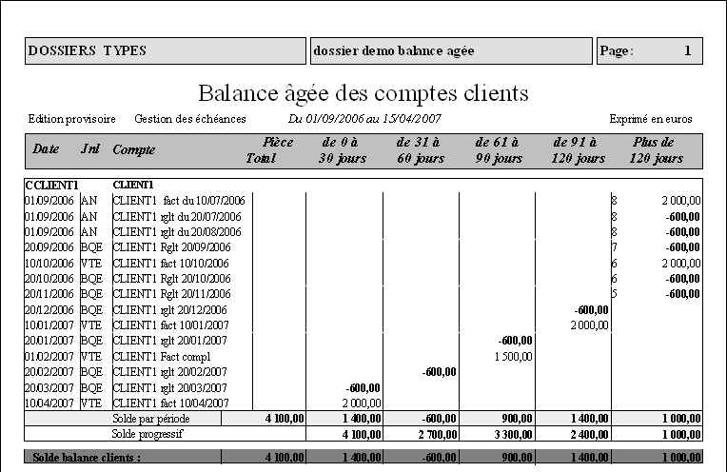
Paydex, Altares’ score to predict companies’ insolvency risk is a very high value-added asset since it is based on very “hot” and hard-to-get inter-company payment data
Data collection
Altares' Paydex score statistically measures the promptness of a company’s payments to its suppliers and vendors…
… based on data coming from accounts receivable information of over 15.000 member companies worldwide
It shows the average number of days’ payment delay, based on a minimum of three trade experiences (from three different suppliers) and presents the payment behaviour (e.g. in advance, with delay…)
A payment experience is a company’s average payment performance with one of its suppliers (who are DunTrade partners), over an 8-month period
The primary objective of the Paydex score is to predict delinquency or default of companies
Apart from assessing risk, this score can help to design the best debt collection or business development strategies
Illustration of a “Balance agée”
And can be used to calculate other scores such as the failure score, which the customer can use for its decision-making processes
Altares – D&B’s partner in France, Benelux and North Africa – uses DunTrade to enhance its scores and publish its payment habit analyses
Analysing payment performance can enable enterprises to assess a company’s insolvency risk (customers or prospects) as 25% of bankruptcies in France are due to payment delays or defaults
The Paydex score is not only useful for predicting bankruptcy: it can also help businesses increase their revenue by focusing on clients with a good payment record
The Paydex score is almost impossible to reproduce and give Altares a powerful edge with its default score calculation compare to competition
Failure Score (inversely proportional to the failure probability)
Decision: The probability of failure becomes 6 times higher for companies with payment delays of 30 to 69 days
1st delay
Repeated late payment
Privileges
Unpaid debts
Suspension of payment
Filling for bankruptcy
Time
Sources: eleven research & analysis, company data, interviews with management

Slide 62
Overview of Altares’ core assets
Altares' offering and value proposition
Altares’ comprehensive offering
Altares’ premium value proposition
Altares’ loyal, resilient and diversified client base
Overview of the client base
Detailed analyses on French client base
Detailed analyses on Benelux client base
Detailed analyses on Manageo client base
Highlight of Altares’ other core assets
Altares’ structuring partnership with Dun & Bradstreet
Altares’ high-quality comprehensive data collection
Altares’ fine-tuned operating model
Appendix
Page 3
Page 5
Page 16
AGENDA
Page 22
Page 27
Page 39
Page 51
Page 60
Page 62
Page 66
Page 71

Slide 63



Operating model
Altares “data factory” is a fine-tuned operating model split into six main steps from data collection & integration to data analysis & workflow integration
Day-to-day operations
1
1
Synthetic View of Altares' day to day operations in France (“Run”)
Upstream : data collection and integration
Downstream : data analysis and workflow integration
Data collection (structured and non structured data)
Data cleansing and processing
Data storage
Data analysis and enrichment
Customer Onboarding and success
Support
Main tasks
Collect data through different sources:
Official documents reading
Buying through partnership and broker
Scraping
NLP
…
Ensure data quality through DQM processes:
Matching
Cleansing and uniformization of data
Automatic and manual correction
Quality control
…
Meet clients’ needs:
Building of personalized scoring algorithm
Choosing relevant data
Modeling of clients’ use cases
Visualization frameworks
Ensure delivery of the solution
Different levels of onboarding depending on the level of complexity/personalization of the product
Level 1 (platform)
Level 2 (Batch)
Level 3 (API) (professional services involved deploy solutions at clients’)
Aftersales support
Tools & partners
Altares' proprietary software to collect and treat data
Phoneo: external provider for Pdf reading automation and reading of legal notices
Service Point: data cleaning provider in Vietnam and Surinam
Local providers: investigation on capital links
Deployed within Engage project
Skills
Data collection
Data quality
Delivery design
Customer service management
Linkage and investigation
Fulfilment
Customer support
Product Owners, Data scientists, Infrastructure and Network, Engage leader…
Sources: eleven research & analysis, company data, interviews with management

Slide 64



Operating model
Furthermore, Altares' operations are supported by continuous R&D and a strong IT architecture
R&D operations
2
2
Synthetic View of Altares’ offering improvement and R&D operations
Upstream : data collection and integration
Downstream : data analysis and offering deployment
Data collection (structured and non structured data)
Data cleaning and treatment
Data storage
Data analysis and fulfilment
Customer Onboarding and success
Sales and support
R&D on data collection and cleansing
Scoring algorithm improvement
Product IT development
(APIs, connectors, Webservices)
Main tasks
Data Science teams in France and Benelux deliver scoring, analytics and predictive models projects
It is also specialized in Natural language processing (NLP) technology used to “read” documents, web sites, press information and to “write” texts added to products and on-line contents
Several technology-based add-ons are to be integrated in order to improve products, incl.:
NLP project to integrate companies-related news into products: A POC has been performed with an external provider with the estimation of the project feasibility and the development timeline (5 to 6 months of development), therefore, the product should be released in Q4 2021
Machine learning project of score precision enrichment with clients’ inputs: with the objective to enable Altares’ client to visualize and modify the different elements that constitute their score (e.g. outdated annual balance sheet that can be updated)
Digital identity management with SSO (Single Sign-on) allowing client to switch from one product to another (in 2022)
Ongoing development of the Common Platform (DataHub) project with aim to build a unique layer of APIs for the group enabling to do requests in old databases of each product for the group
See infra the Common Platform project
Tools
Skills
Product Owners, Data scientists, Infrastructure and Network, Engage
Sources: eleven research & analysis, company data, interviews with management

Slide 65


Altares’ group operations are supported by a resilient but aging technical architecture that is being modernized within the Common Platform project
Operating model
Datahub project
Simplified scheme of Altares' current and targeted IT architecture within the DATA HUB project
Current IT architecture
Targeted IT architecture
Platform 1
Platform 2
Platform …
D&B products
…
D&B Products
…
Front
App
App
App
Apps
Layer of APIs with API management tool
Back
intuiz
Database
IndueD
Database
Database …
D&B
Database
intuiz
database
indueD
database
database …
D&B
Database
Altares “Data Factory”
Altares “Data Factory”
Monolithic and closed platforms for each product
Heavy legacy
Old computer development language
Bad time to market
Unique layer of APIs enabling to do request in old databases of each product for the group
Betted time to market thanks to unified APIs
Better flexibility to improve the front of Altares proprietary products and thus increase independence from D&B
Sources: eleven research & analysis, company data, interviews with management

Slide 66
Overview of Altares’ core assets
Altares' offering and value proposition
Altares’ comprehensive offering
Altares’ premium value proposition
Altares’ loyal, resilient and diversified client base
Overview of the client base
Detailed analyses on French client base
Detailed analyses on Benelux client base
Detailed analyses on Manageo client base
Highlight of Altares’ other core assets
Altares’ structuring partnership with Dun & Bradstreet
Altares’ high-quality comprehensive data collection
Altares’ fine-tuned operating model
Appendix
Page 3
Page 5
Page 16
AGENDA
Page 22
Page 27
Page 39
Page 51
Page 60
Page 62
Page 66
Page 71

Slide 67
Synthesis of the databases used to perform eleven’s analyses
Altares’ clientbase
1
2
Altares’ different client base
3
Evolution of revenue, France, €m
Evolution of revenue, BNL, €m
Evolution of revenue, Manageo, in €m
Revenue
Evolution of billing values per type of contracts, France, €m
Evolution of booking values per type of contracts, BNL, €m
Evolution of commercial invoiced, provisions and deferred, Manageo, €m ¹
Client analyses
Evolution of Total Price of won opportunities, France, in €m ²
Evolution of Total Sales Price of won opportunities, BNL, in €m
Evolution of Total Sales Price of won opportunities, Manageo, in €m
53.15
54.09
Pipeline Analyses
Scope of pipeline analyses
Scope of pipeline analyses
49.5
(52.8 incl. Pay as you go)
2019
2020
2019
2020
2019
2020
Renewal (excl. D&BI)
Renewal D&BI
NetNew
Sources: eleven research & analysis, company data
1. FAE (invoices to be established) + PCA (prepaid revenue) - AAE (prepaid expenses) 2. Others include alliances, partnerships and barter

Slide 68
Both interviews and reference materials coming from internal and external sources have been leveraged throughout eleven’s analyses
Management interviews
Expert calls
General management
Luc Querton, CEO
Frederic Barth, MD France
David Verheecke, MD Benelux
Thomas Poussardin, MD Manageo
Rania Aouad, Head of IT
Nicolas Godard, Head of Finance
Gildas Delon, Head of HR
Nicolas Pintart, Head of Product & Strategy
Sales team
Interviews with the sales team in France, in Netherlands, and in Belgium & Luxembourg
Interview with the North-Africa Director
Other key people
Interviews with the product managers related to risk, B2B marketing/Manageo, compliance, D&B products
Interviews with the Operations Directors in France, and in Benelux
Interview with the Data Science Director in Benelux
Interview with the Director of International development
...
Europe
Managing Director Europe at a BD&A player, former Sales Director at another BD&A player (EU)
Former Sales Director at a BD&A player & Current Associate director Sales at another BD&A player (NL)
Director Marketing, Consulting, and Finance at a BD&A player (BE)
Former Managing Director at a BD&A player (BE)
Former Commercial Development Manager at a BD&A player, former marketing at another BD&A player (FR)
Legal & Compliance Director at a big corporate (EU)
Benelux
French
Client calls
Telecom (FR)
Industry (FR)
Health (FR)
Finance (NL)
Finance (NL)
Industry (BE)
2 Manageo’s customers (agency and small business)
Industry reports
Thomson Reuters: Cost of Compliance 2019: 10 years of regulatory change, by S. English and S. Hammond
FERMA European Risk Manager Report (2020)
Pwc: Le Baromètre du risk manager (2019)
Xerfi studies: Les services de gestion du compte clients à l’horizon 2020 (2018)
IDC: European Data Market (2017)
Industrial Marketing Management, by H. Hallikainen, E. Savimäki and T. Laukkanen (2019)
Euler Hermes: Covid-19 to increase firms’ liquidity needs to a record USD8TN as payment delays and inventories surge (2020)
OFCE: Dynamique des défaillances d’entreprises en France et crise Covid-19 (2020)
Banque de France, Observatoire des délais de paiement (2018.2020)
Ministère de l’économie et des finances, Communiqué de presse (2020)
Ministère de l’Europe et des Affaires étrangères, rapport (2020)
Company information
Company data and corporate documents
Customer database from the customer intelligence data team
Management’s Business Plan
Altares’ macro-economic market studies on risk indicators in France and Benelux
...
...
Note: Non-exhaustive lists

Slide 69


Paris Office
78 Avenue Raymond Poincaré
75116 Paris
London Office
1 Ropemaker Street, Level 10
London EC2Y 9HT
Maxime Caro
Partner
+33 6 32 96 87 72
maxime.caro@eleven-strategy.com
Théodora Dupont-Courtade
Manager
+33 6 33 37 84 60
Theodora.dupontcourtade@eleven-strategy.com

